Slide 1
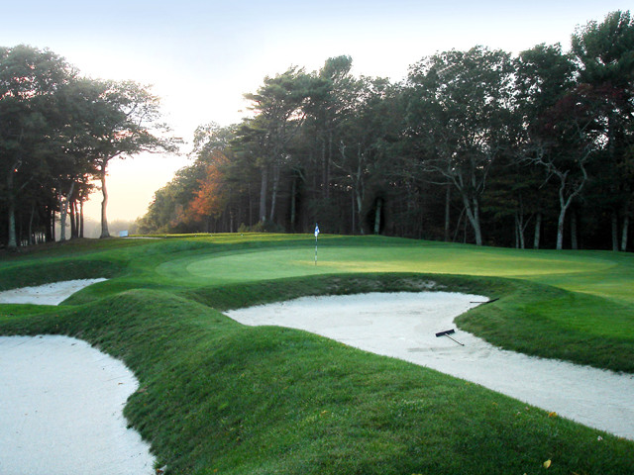
SAVE THE DATE… MONDAY, MAY 20TH, 2024
Cape Cod WARRIORS SOAR Golf Classic
Scramble Format
Registration: 10:00 AM
Lunch: 11:30-12:45
Shotgun Start: 1:00 PM
Pocasset Golf Club
24 Clubhouse Dr.
Pocasset, MA 02559
For additional info, go to: warriorssoar.org From menu, go to Cape Cod Golf Classic
30
Join us at
Pocasset Golf Club

Slide 2
RESERVE YOUR SPOT TODAY
_____Yes, I plan to attend as a single golfer…
Name___________________________________________email_________________________________HDCP________
Yes, I plan to attend and bring a foursome…
Name____________________________________________email_________________________________HDCP________
Name____________________________________________email_________________________________HDCP________
Name____________________________________________email_________________________________HDCP________
Name____________________________________________email_________________________________HDCP________
_____I will not be able to attend,
but am interested in sponsoring a Veteran for golf
_____I am interested in making a donation in-kind to the golf event
_____I am interested in donating items for the Silent Auction
_____I am interested in becoming a sponsor
Make checks payable to: WARRIORS SOAR• Mail to: Cape Cod Warriors Soar • 117 Hammond St., Newton MA, 02467
Event questions? Contact William McLaughlin (617) 921-7036 32hathaway@gmail.com
Golf Opportunities | $
Individual Golfer | $295.00
Team(s) of 4 | $1000.00
Super Ticket (includes 2 mulligans, putting contest, 1 Raffle tickets, Closest to line, Closest to pin. ($80.00 Value!) | $50.00
Mulligans (2) (available at event) | $20.00
Raffle Ticket (ea.) (available at event) | $10.00
Putting Contest | $10.00

